Slide 1
Open Source Platform and Network Administration
Lesson 12

Slide 3
Linux System Administrator
Turns off or uninstalls unused services.
Ensures services do not run as root.
Runs services in chroot jail when appropriate.
Restricts access to services only to necessary users and applications.
Uses bastion hosts for server services and keeps services updated with latest security fixes.

Slide 4
chroot Jail
Use chroot jail:
To enable an application access its own set of libraries and directory structure
To restrict access to users on a system
To run software such as Berkeley Internet Name Domain (BIND)
Notes:
Chroot is not a replacement for bastion hosts and/or virtual servers.

Slide 5
Summary
Commonly installed Linux services
Bastion hosts
Bastion host hardening
Disabling unneeded services and removing unneeded packages
chroot jails

Slide 6
Virtual Lab
Hardening Security for Linux Services and Applications
Notes:
If your educational institution included the Jones & Bartlett labs as part of the course curriculum, use this script to introduce the lab:
"In this lesson, you examined the security-related features of a number of services. The more complex they are, the more important it is to keep the installed and enabled features to a minimum. You discussed vulnerabilities in Linux services and their mitigations.
In this lab, you will configure security and hardened services and applications to ensure the confidentiality, integrity, and availability of those services. You will configure and secure an Apache Web server and MySQL database and the components necessary to harden the security implementation of both. You also will configure the Sendmail application for secure local messaging and will enable secure, encrypted remote access using Secure Shell (SSH). "

Slide 7
OPTIONAL SLIDES

Slide 8
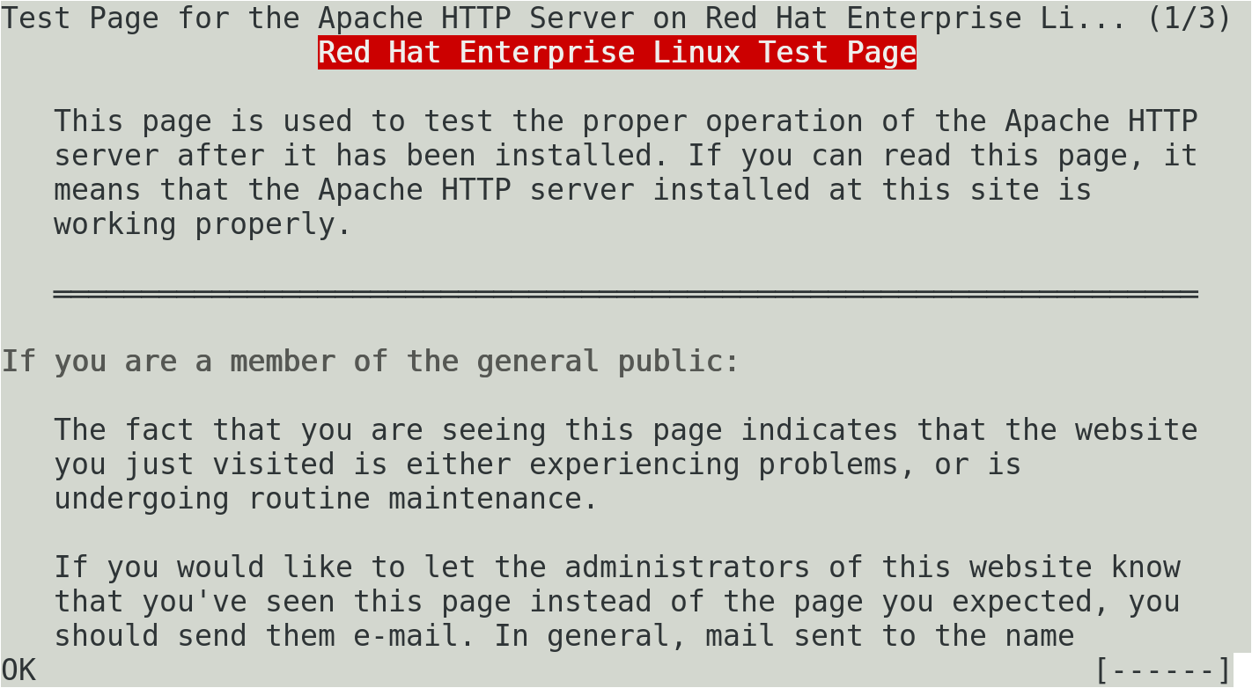
The elinks Web Browser
Notes:
Many excellent text- and console-based tools are available for Linux. These tools can be used to check data from a number of different “graphical” services. For example, elinks is a console browser that you can use to review data from Web servers.
On a Red Hat system with a running Apache Web server, the elinks 127.0.0.1 command returns the page shown above.

